Slide 1


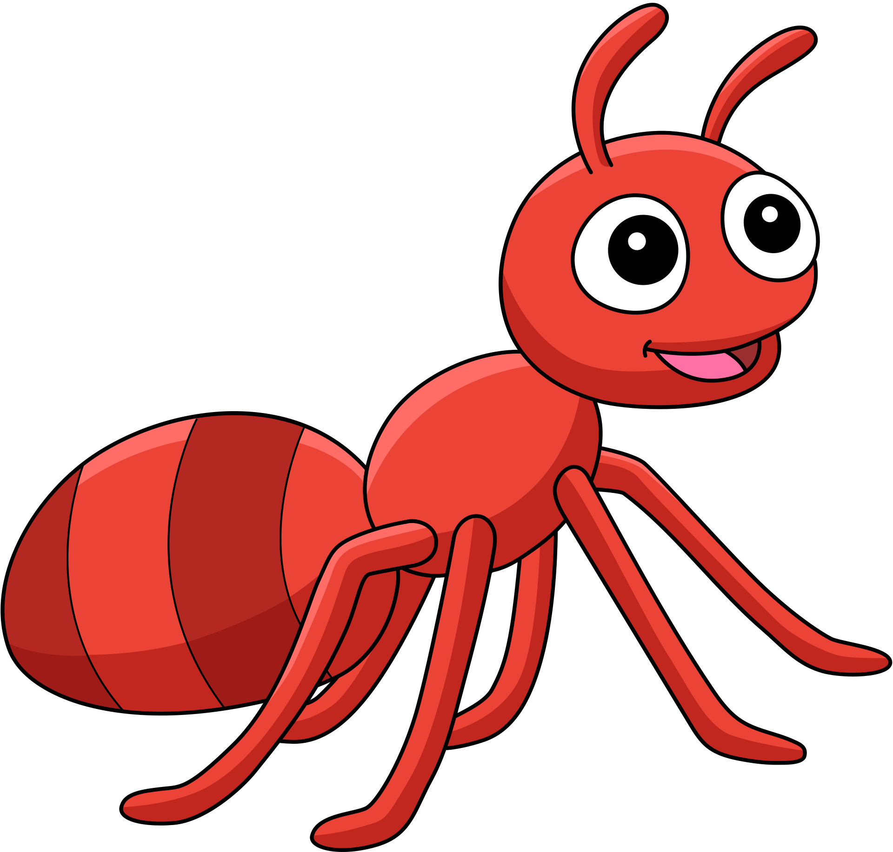
NEST-SITE SELECTION IN MASS-RECRUITING ANT SPECIES
Collective Behaviour
Meggy-Lie-Anne Chamand, Kim Georget, Bella Muradian, Clara Stavun
15/01/2024

Slide 2
2
OUTLINE
I- Introduction
II- Method
  Set up
  Implementation
  Tests
III- Results
IV- Discussion and conclusion
Outline

Slide 3
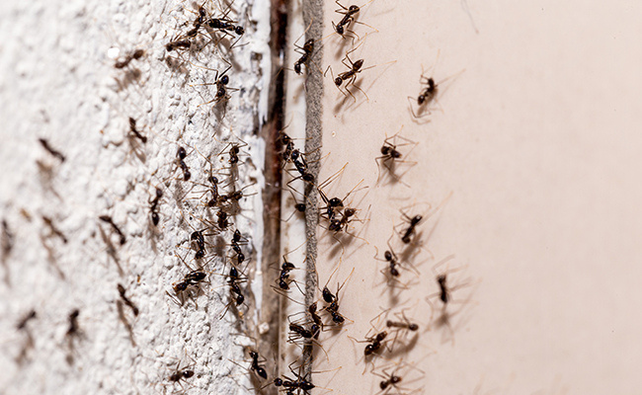
3
INTRODUCTION
Context:
  Have a better understanding of the behaviour of social insects such as ants
  Study the process of new nest selection of the M. nipponica ant
  Apply this knowledge in various fields (robotics, ...)
Introduction

Slide 4
4
RELATED WORK
1
Quorum Sensing
Nest-site selection depends on the cumulative pheromone threshold, aligning with observed ant behavior.
Introduction
Heterogeneous Acceptance Thresholds
Ants exhibit diverse acceptance thresholds for nest sites. In this model, thresholds determine the minimum pheromone level required for acceptance
2
3
Variable Individual Assessment Behavior
Ants differ in their assessment behavior, some favoring proximity to food sources, while others prioritize concealment from predators.

Slide 5
5
AN AGENT-BASED MODEL OF NEST-SITE SELECTION IN A MASS-RECRUITING ANT
By Adam L. Cronin
Model of the house-hunting process of ants : they combine the use of pheromone trails with a quorum decision rule in collective decisions among nest sites when searching for a new home.
Introduction

Slide 6
6
PROBLEM
First Problem
Second Problem
Understanding the influence of parameters on decision-making, speed, and accuracy
  Classifying nests as more or less favorable based on the environment
  Making ants select the best nest by dynamically adjusting their threshold
  Testing the influence of different parameters on model output
Introduction
Third Problem
Enhancing the model to minimize the agents' errors as much as possible

Slide 7
7
OBJECTIVES
Reproduce the model
Improve the model
Reproduce the inital model
Improve the model
  Based on the research paper
  Use of the Netlogo platform
  Tests with multiple configurations :
    have a visual representation
    verify the results obtained
  Add elements to the environment (food, protection, predator)
  The ant aim to find the best nest : use of a dynamical threshold
  Ants classified nests as “bad” or “good” according to their own threshold
  Based on the research paper
  Use of the Netlogo platform
  Tests with multiple configurations :
    have a visual representation
    verify the consistency of the results obtained
  Add elements to the environment (food, protection, predator)
  The ant aim to find the nest with the highest score : use of a dynamical threshold
  Obtain optimal model
Introduction

Slide 8
8
MODEL PARAMETERS
Two agents
3 main ant parameters
  Nest :
    Quality number (20 to 90) : depends of the environment
    Quality class : “good” or “bad” : depends of the quality number
    Number of ants that visited the nest
  Ant :
    Chosen nest : defined when an ant finds a potential good nest
    Either move randomly or go to a nest they know the position of.
    Threshold : to classify nests
  Quorum percent
  Commitment-base
  Pheromone deposition
Method
Four types of ants
  Nest ants
  Scout ants
  Decided ants
  Transport ants

Slide 9
9
SET UP
Initial model
  Visual representation of ants and nests (shape, size, position, quality)
  Possibility for the user to change some parameters (colony size, quorum percentage, etc.)
  Quality of each nest set randomly
  Simulation : observation of ant movements and results displayed
Update
  Possibilty for the user to add 3 parameters (food, protection, predator) near each nest
  Visual representation of these parameters
  Quality of each nest defined by the environment
Method

Slide 10
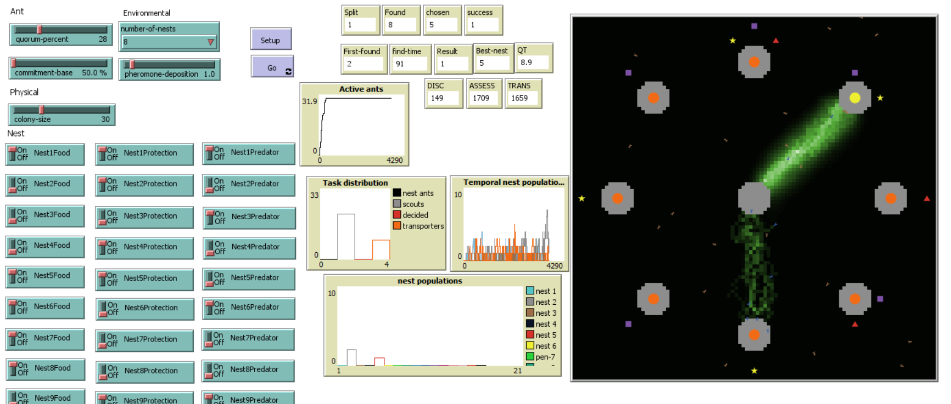
SET UP
10
Method

Slide 11
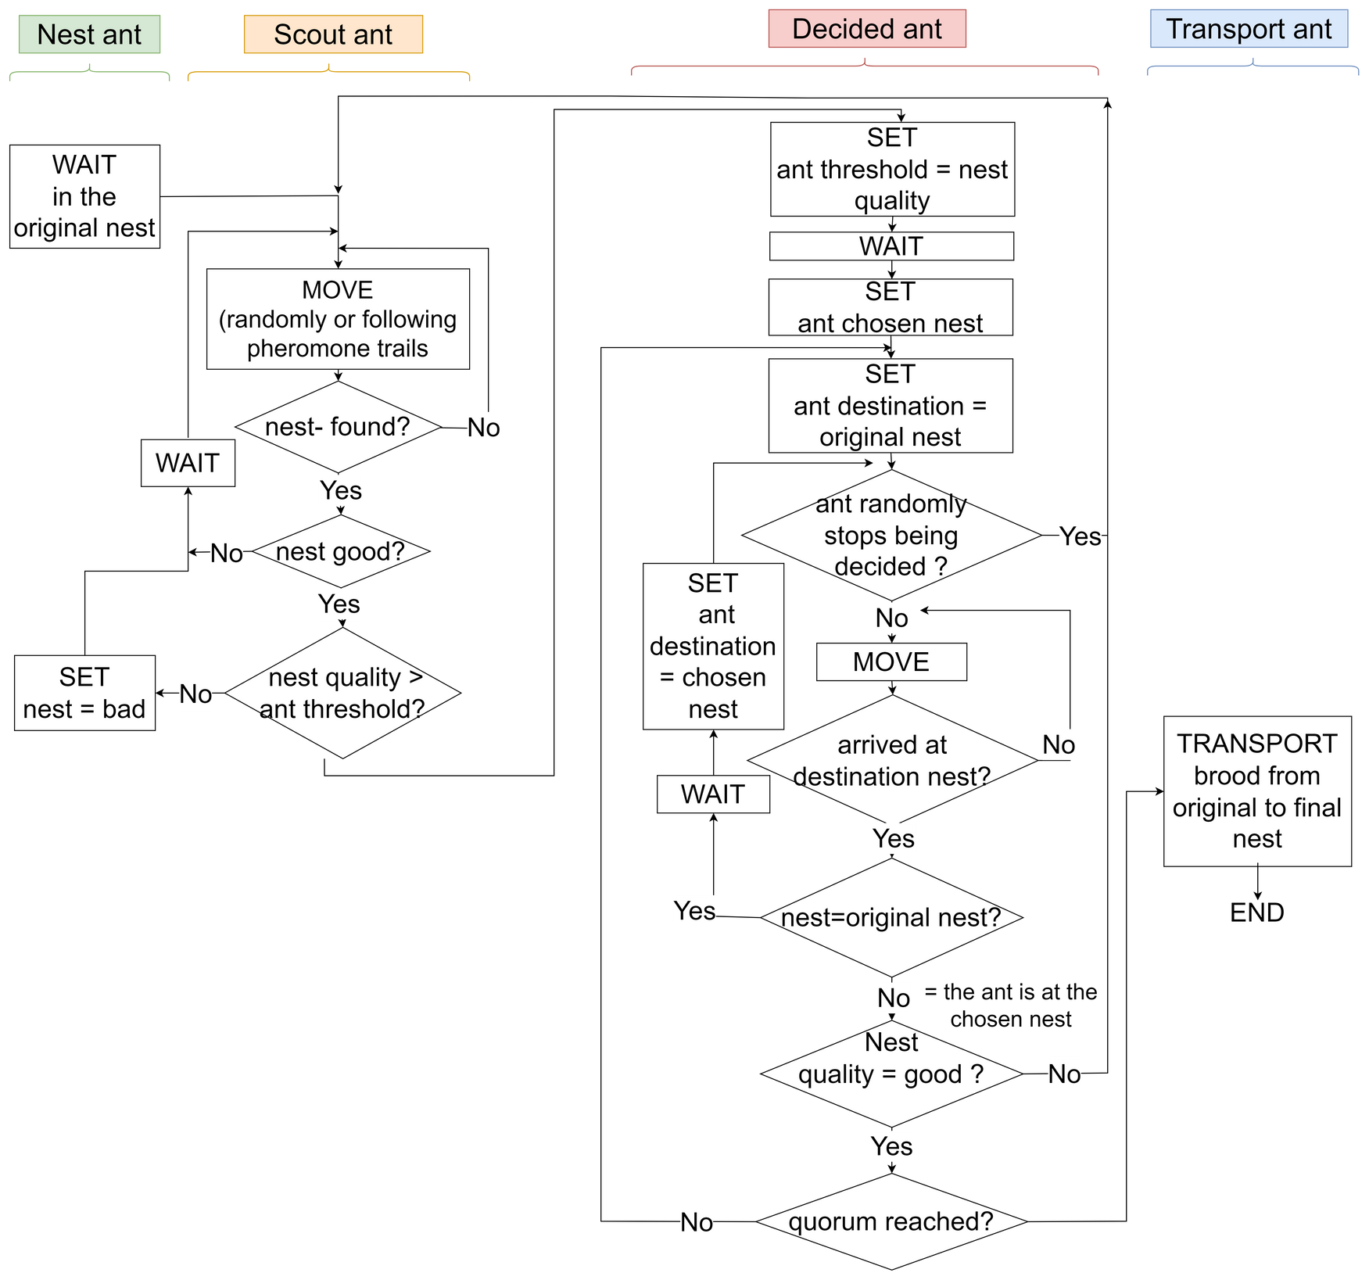
11
Simulation

Slide 12
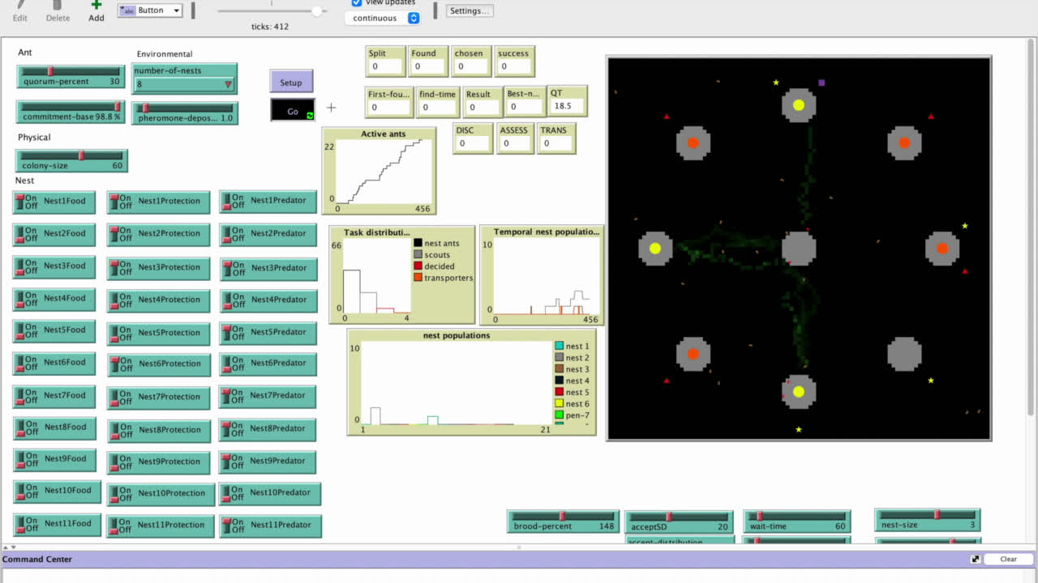
12
Simulation

Slide 13
13
TESTS
Parameters
Goals
Three key parameters :
  quorum percentage
  commitment-base percentage
  pheromone deposition
  Assess ants' ability to find the best nest in diverse environments
  Study the impact of the specified parameters
  Identify precise values of the parameters that yielded optimal model results
Method
Configuration
  Different combinations of these parameters
  Various nest configurations :
    number of nests
    quality of nests
    position of nests

Slide 14
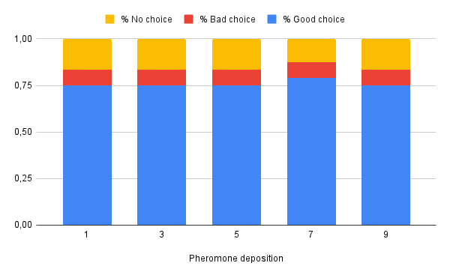
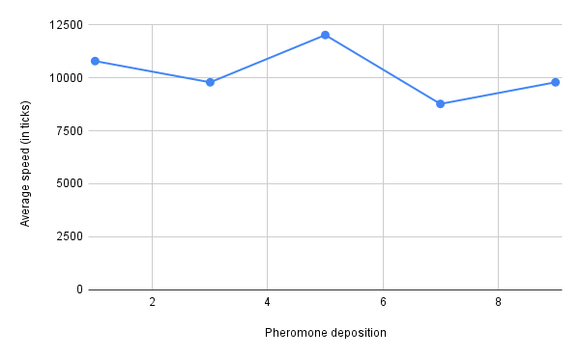
14
﻿RESULTS
Pheromon deposition : No impact with this model
Pheromon deposition influence on new nest selection
(with 8 nests)
Speed of the new nest emigration depending on the pheromone deposition
(with 8 nests)

Slide 15
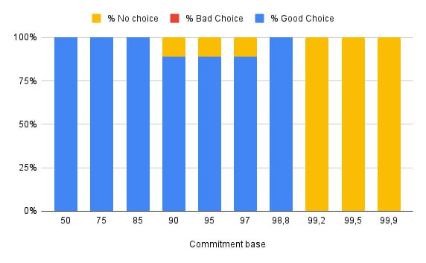
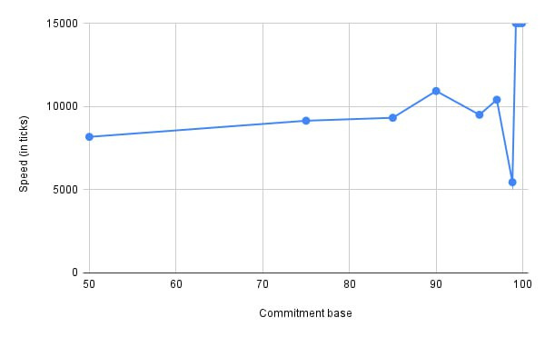
15
﻿RESULTS
Pheromon deposition : No impact with this model
Commitment-base percentage : [98% ; 98.9%]
Commitment-base percentage influence on new nest selection
(with 8 nests)
Speed of the new nest emigration depending on the commitment-base percentage
(with 8 nests)

Slide 16
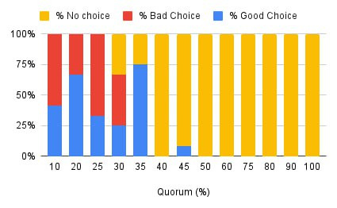
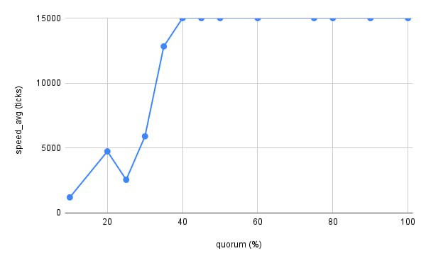
16
﻿RESULTS
Pheromon deposition : No impact with this model
Commitment-base percentage : [98% ; 98.9%]
Quorum percentage : 35%
Quorum percentage influence on new nest selection
(with 8 nests)
Speed of the new nest emigration depending on the quorum percentage
(with 8 nests)

Slide 17
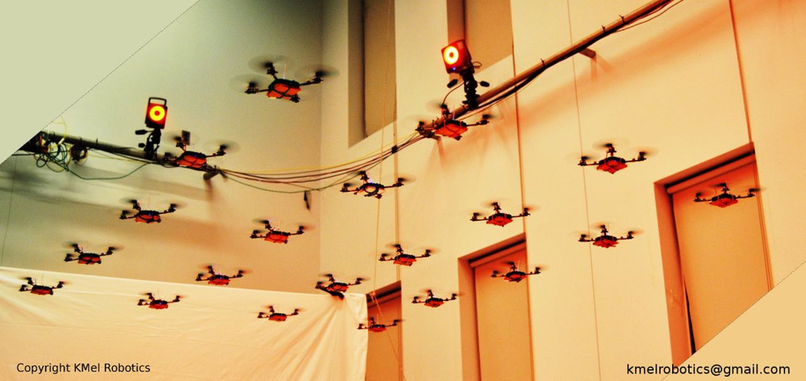
17
DISCUSSIONS
Possible enhancement
Model's current constraint : nest placement (centered around the original nest)
Enhancement : include randomness (for a better representing real-world unpredictability)
Application in various field
Particularly in fields like robotics and rescue missions.
Ant colony's decision-making mechanisms could be adapted to :
  improve the efficiency of robotic swarms in unknown environments
  optimize rescue teams' strategies in disaster scenarios
Discussions

Slide 18
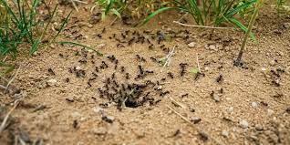
18
CONCLUSION
By delving into the collective decision-making processes of ant colonies and refining existing models to include key parameters like quorum percent and commitment base, we have uncovered nuanced dynamics that govern how these insects navigate complex challenges.

Slide 19
University of Ljubljana | 2024
THANK YOU

