Slide 1

Statistical Predictive Modeling
University of Ljubljana, Faculty of Computer and Information Science
Prof Dr Marko Robnik-Šikonja
Intelligent Systems
Edition 2025

Slide 2
Learning
Learning is the act of acquiring new, or modifying and reinforcing existing, knowledge, behaviors, skills, values, or preferences
and may involve synthesizing different types of information.
Statistical learning deals with the problem of finding a predictive function based on data.
The primary goals of statistical learning: prediction and understanding.
Many different learning settings and data types, rapidly spreading in many areas of science, technology, and analytics, e.g., the Nobel prize in physics in 2024 to Hopfield and Hinton

Slide 3
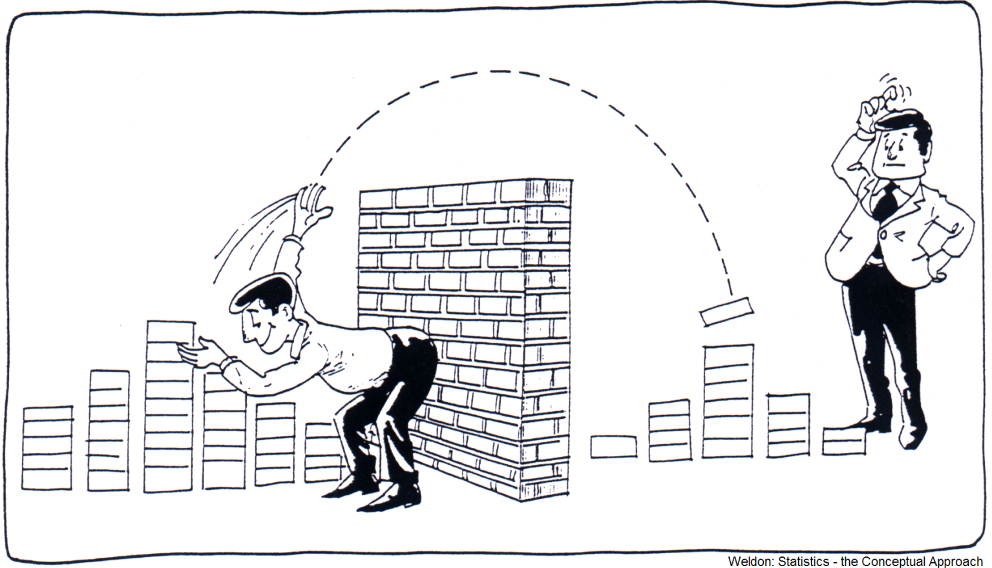
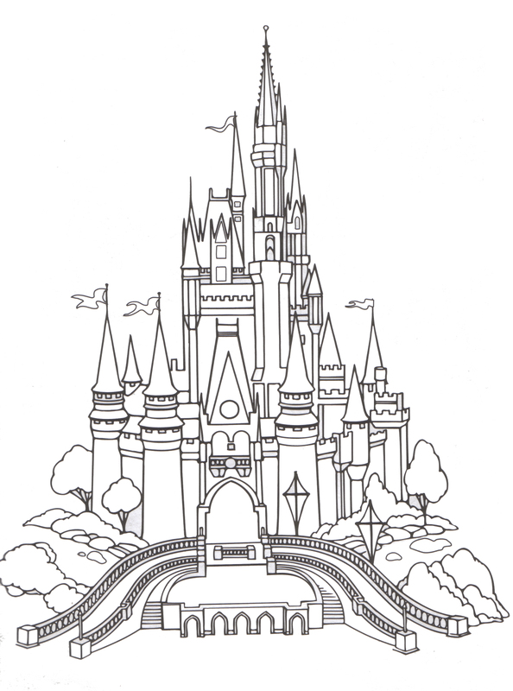
Statistics and machine learning
Definition from Wikipedia:
ML algorithms operate by building a model from example inputs i.e., samples.
ML can also be viewed as compression

Slide 4
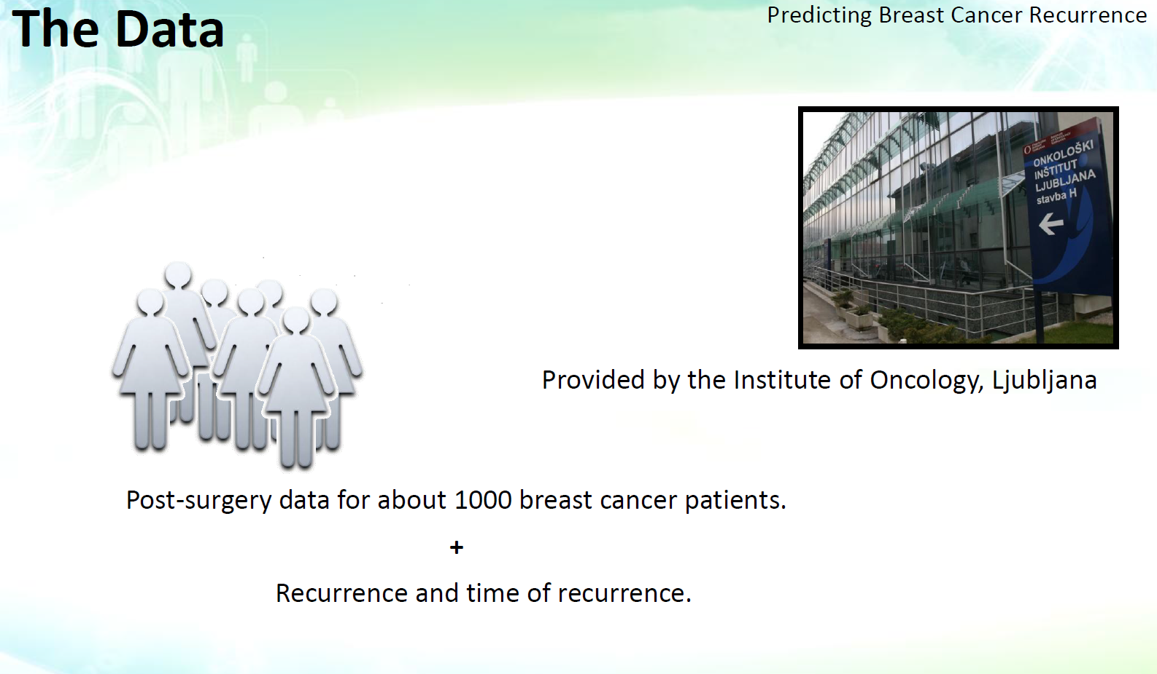

Slide 5
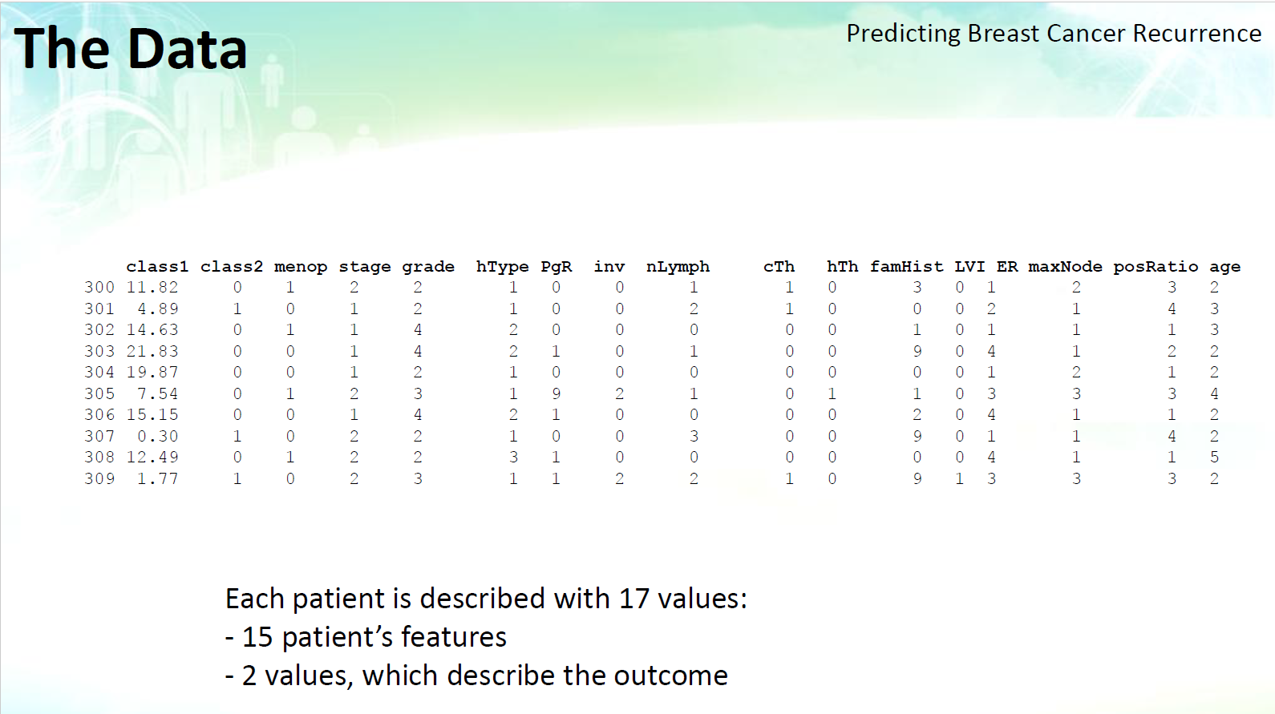

Slide 6
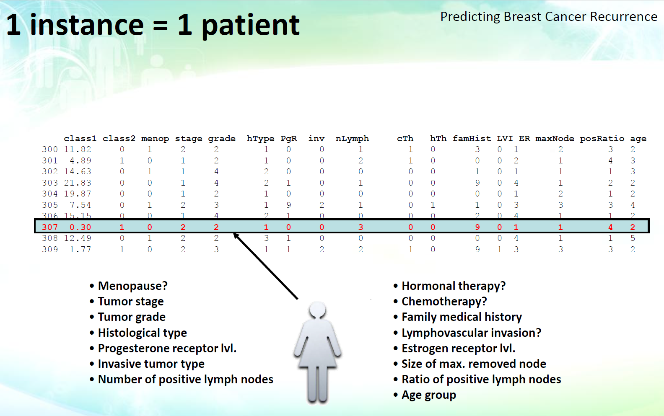

Slide 7
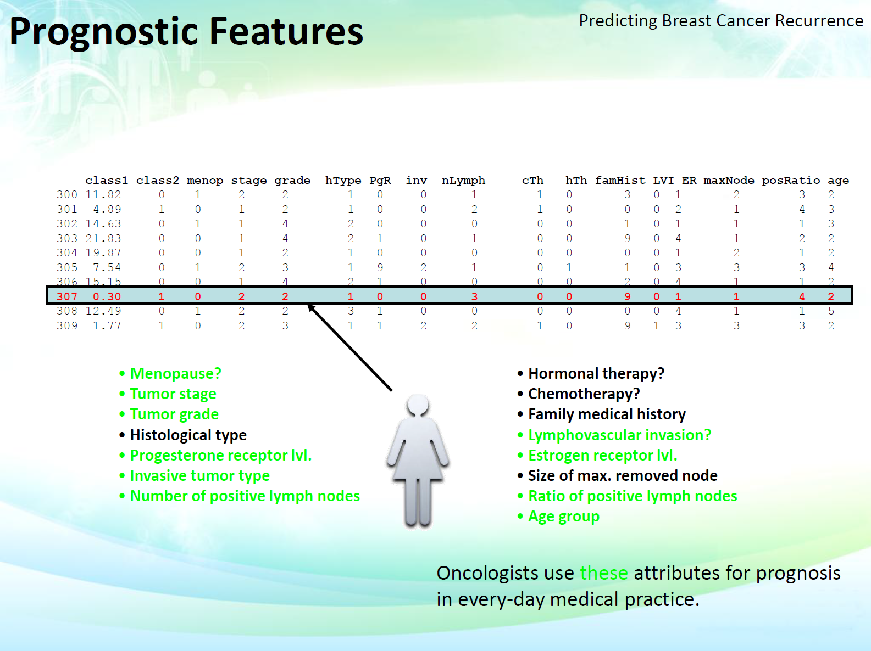

Slide 8
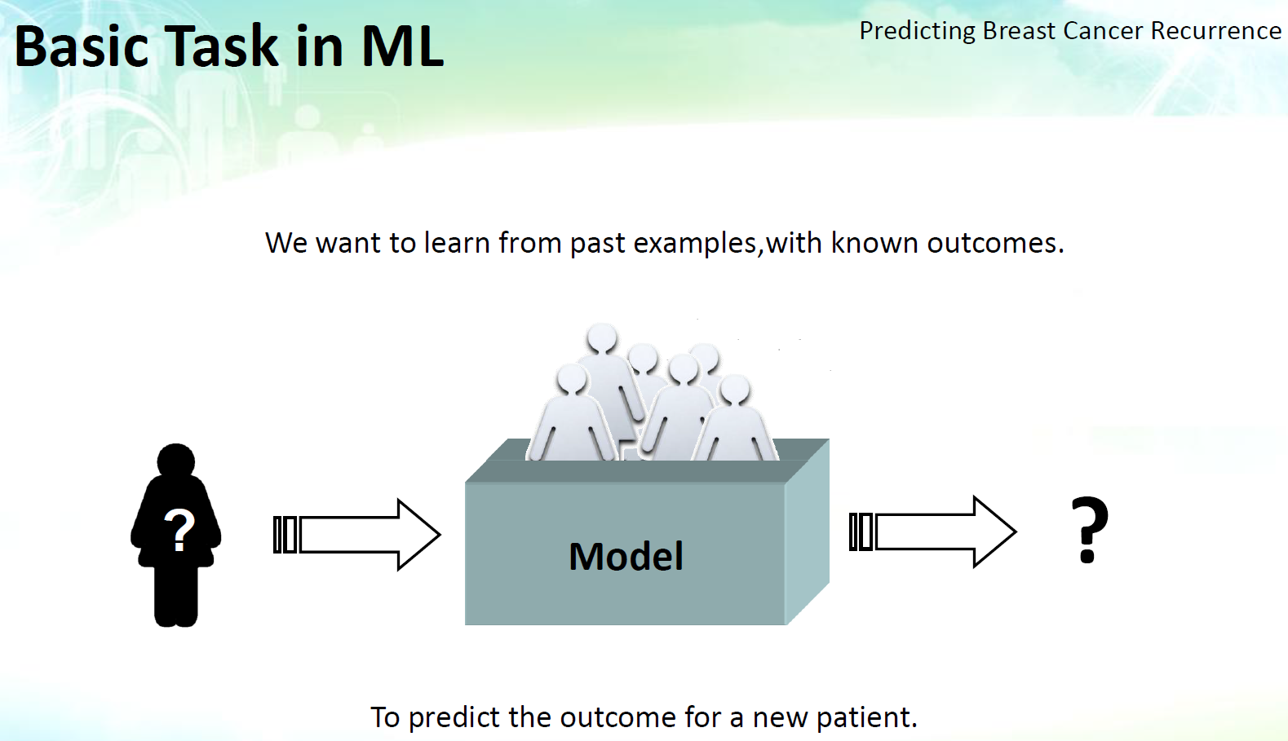

Slide 9
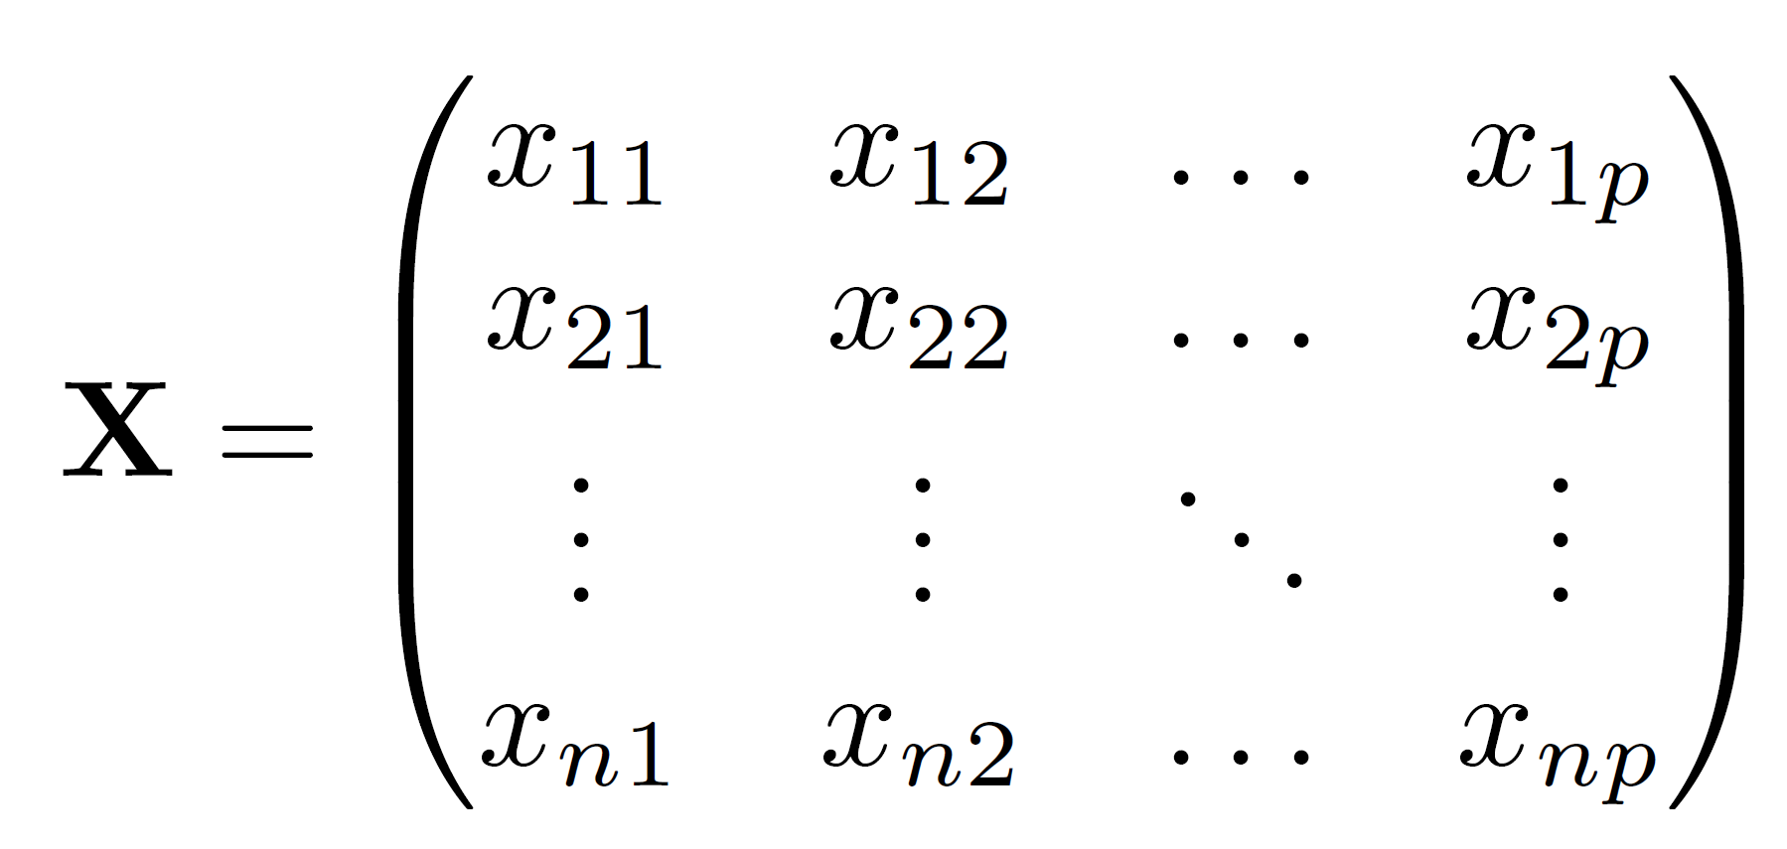
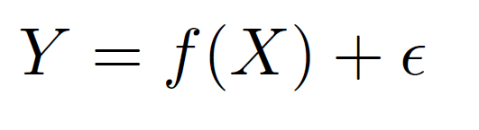
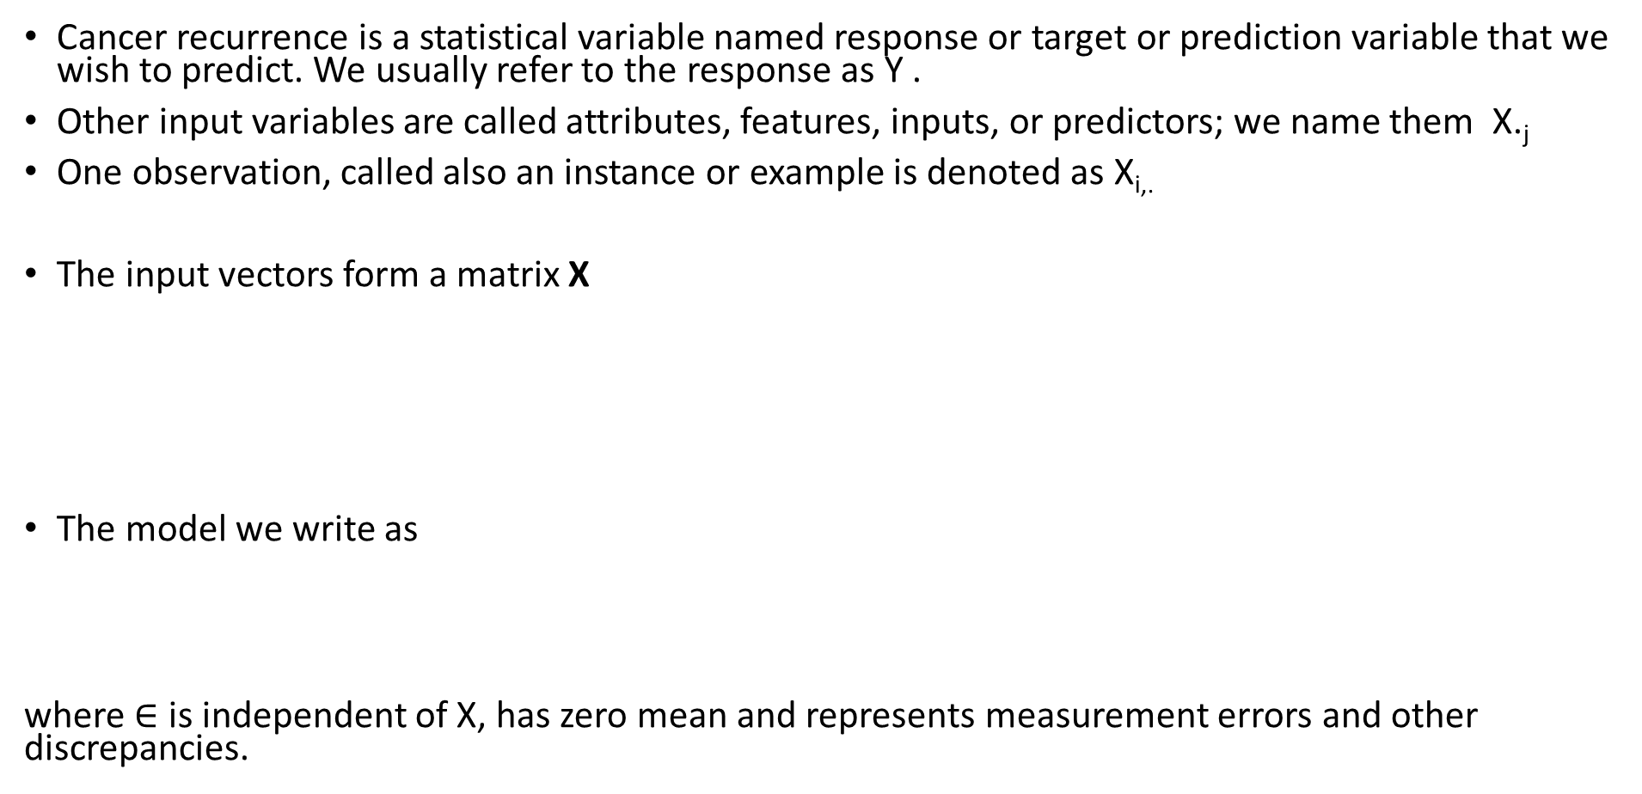
Basic notation of predictive modelling
Cancer recurrence is a statistical variable named response or target or prediction variable that we wish to predict. We usually refer to the response as Y .
Other input variables are called attributes, features, inputs, or predictors; we name them X._{j}
One observation, called also an instance or example is denoted as X_{i,.}
The input vectors form a matrix X
The model we write as
where $∈$ is independent of X, has zero mean and represents measurement errors and other discrepancies.

Slide 10
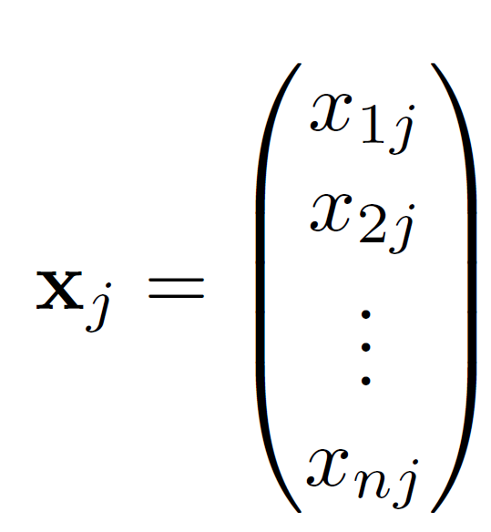
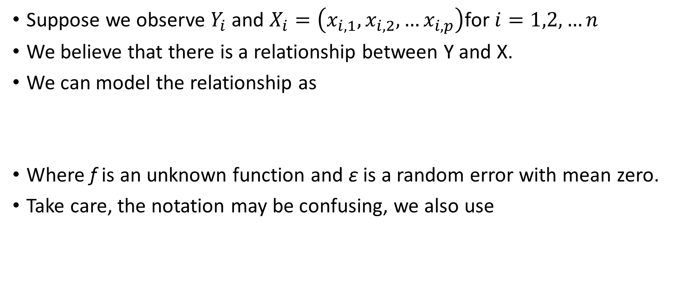
Further notation for instances and attributes
Suppose we observe $Y_{i}$ and $X_{i}=\left(x_{i,1},x_{i,2}, …x_{i,p}\right)$for $i=1,2,…n$
We believe that there is a relationship between Y and X.
We can model the relationship as
Where f is an unknown function and ε is a random error with mean zero.
Take care, the notation may be confusing, we also use

Slide 11
A simple example

Slide 12
A simple example
Assuming we know f (in red)
ε_{i}
f

Slide 13
Different standard deviations of error
The difficulty of estimating f will depend on the standard deviation of the ε’s.

Slide 14
Different estimates for f

Slide 15
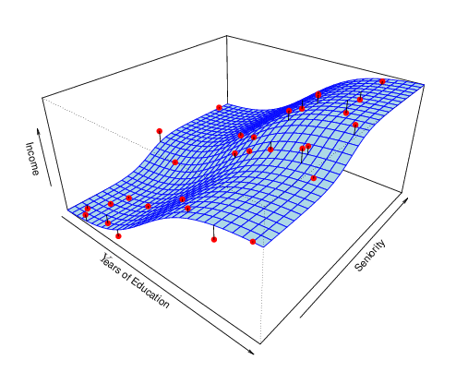
Income vs. Education and Seniority
Multidimensional X

Slide 16
1st goal of learning: prediction
If we can produce a good estimate for f (and the variance of ε is not too large), we can make accurate predictions for the response, Y_{i}, based on a new value of X_{i.}
Example: Direct Mailing Prediction
  Interested in predicting how much money an individual will donate based on observations from 90,000 people on which we have recorded over 400 different characteristics.
  Don’t care too much about each individual characteristic.
  Just want to know: For a given individual should I send out a mailing?

Slide 17
2nd goal of learning: inference
often we are interested in the type of relationship between Y and all the X_{.j}
For example,
  Which particular predictors actually affect the response?
  Is the relationship positive or negative?
  Is the relationship a simple linear one or is it more complicated, etc.?
  For a given (X_{i.}, Y_{i}), which feature values x_{ij} are the most important to determine y_{i}?
Sometimes more important than prediction, e.g., in medicine.
Example: Housing Inference
  Wish to predict median house price based on 14 variables.
  Probably want to understand which factors have the biggest effect on the response and how big the effect is.
  For example, how much impact does a river view have on the house value etc.

Slide 18
How do we estimate f?
We will assume we have observed a set of training data
We must then use the training data and a statistical method to estimate f.
Statistical Learning Methods:
  Parametric Methods
  Non-parametric Methods

Slide 19
Parametric methods
They reduce the problem of estimating f down to one of estimating a set of parameters.
They involve a two-step model-based approach
  STEP 1:
  Make some assumption about the functional form of f, i.e. come up with a model. The most common example is a linear model, i.e.
    More complicated and flexible models for f are often more realistic.
  STEP 2:
  Use the training data to fit the model, i.e. estimate f or equivalently the unknown parameters such as β₀, β₁, β₂,…β_{p}
  For linear model the most common method uses ordinary least squares (OLS).

Slide 20
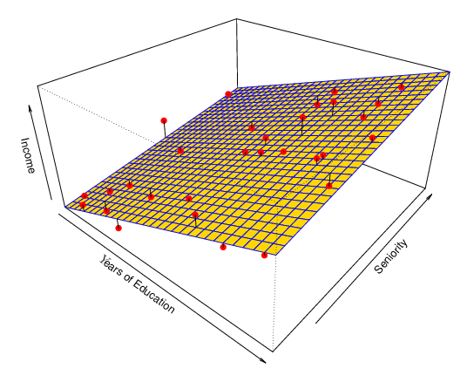
Example: a linear regression estimate
Even if the standard deviation is low, we will still get a bad answer if we use the wrong model.

Slide 21
Non-parametric methods
They do not make explicit assumptions about the functional form of f.
Advantage: They accurately fit a wider range of possible shapes of f.
Disadvantage: A large number of observations may be required to obtain an accurate estimate of f¸.

Slide 22
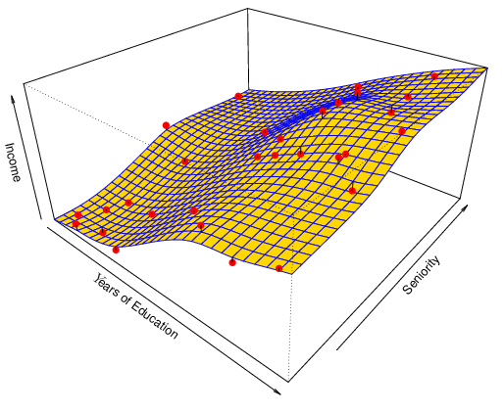
Example: a thin-plate spline estimate
Non-linear regression methods are more flexible and can potentially provide more accurate estimates.

Slide 23
Trade-off between prediction accuracy and model interpretability
Why not just use a more flexible method if it is more realistic?
Reason 1:
A simple method such as linear regression produces a model which is much easier to interpret (the inference part is better). For example, in a linear model, β_{j} is the average increase in Y for a one unit increase in X_{j} holding all other variables constant.
Reason 2:
Even if you are only interested in prediction, so the first reason is not relevant, it is often possible to get more accurate predictions with a simple, instead of a complicated, model. This seems counter intuitive but has to do with the fact that it is harder to fit a more flexible model.

Slide 24
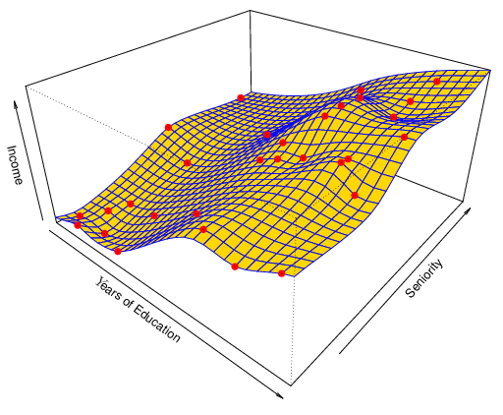
A poor estimate: overfitting
Non-linear regression methods can also be too flexible and produce poor estimates for f.

Slide 25
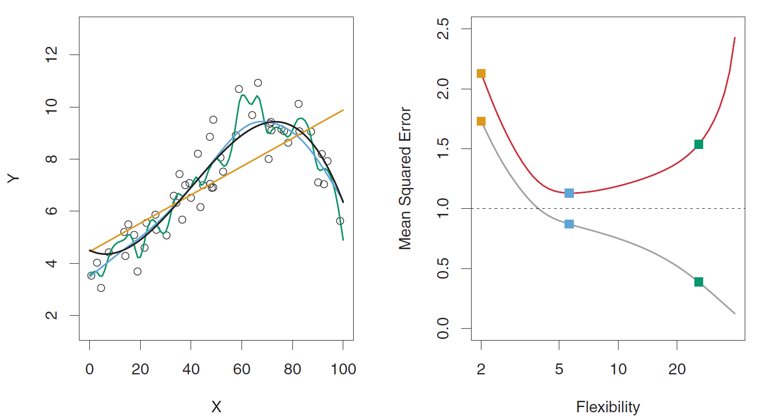
Goodness of fit for three models
LEFT
Black: Truth
Orange: Linear Estimate
Blue: smoothing spline
Green: smoothing spline (more flexible)
RIGHT
RED: Test MSE
Grey: Training MSE
Dashed: Minimum possible test MSE (irreducible error)

Slide 26
Supervised, unsupervised, semi-supervised, self-supervised, weakly-supervised learning 1/2
We can divide learning problems into Supervised and Unsupervised situations
Supervised learning:
  Supervised Learning is where both the predictors, X_{i}, and the response, Y_{i}, are observed.
  e.g., linear regression
Unsupervised learning:
  In this situation only the X_{i}’s are observed.
  We need to use the X_{i}’s to guess what Y would have been and build a model from there.
  A common example is market segmentation where we try to divide potential customers into groups based on their characteristics.
  A common approach is clustering.
    Idea: Maximizing initra-cluster similarity & minimizing inter-cluster similarity
Semi-supervised learning
  only a small sample of labelled instances are observed but a large set of unlabeled instances
  an initial supervised model is used to label unlabeled instances
  the most reliable predictions are added to the training set for the next iteration of supervised learning

Slide 27
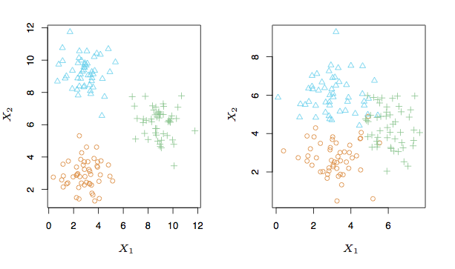
A simple clustering example

Slide 28
Supervised, unsupervised, semi-supervised, self-supervised, weakly-supervised learning 2/2
Self-supervised learning
  a mixture of supervised and unsupervised learning
  learns from unlabeled data
  the labels are obtained from related properties of the data itself, often leveraging the underlying structure in the data
  usually predicts any unobserved or hidden part (or property) of the input from any observed or unhidden part of the input.
  e.g., in NLP, we can hide part of a sentence and predict the hidden words from the remaining words
  e.g., in video processing, we can predict past or future frames in a video (hidden data) from current ones (observed data)
Weakly-supervised data
  noisy, limited, or imprecise sources are used to provide supervision signal for labeling large amounts of training data to do supervised learning
  reduces the burden of obtaining hand-labeled data sets, which can be costly or impractical
  e.g., using a smart electricity meter to estimate household occupancy

Slide 29
Regression vs. classification
Supervised learning problems can be further divided into
Regression problems: Y is continuous/numerical. e.g.
    Predicting the value of certain share on stock market
    Predicting the value of a given house based on various inputs
    The duration in years till cancer recurrence
Classification problems: Y is categorical, e.g.,
    Will the price of a share go up (U) or down (D)?
    Is this email a SPAM or not?
    Will the cancer recur?
    What will be an outcome of a football match (Home, Away, or Draw)?
    Credit card fraud detection, direct marketing, classifying stars, diseases, web-pages, etc.
    Note that we mostly predict probabilities of the categories
Some methods work well on both types of problem, e.g., neural networks or kNN

Slide 30
Data mining (analytics, science): on what kinds of data?
Database-oriented data sets and applications
  Relational database, data warehouse, transactional database
Advanced data sets and advanced applications
  Data streams and sensor data
  Time-series data, temporal data, sequence data (incl. bio-sequences)
  Structure data, graphs, social networks and multi-linked data
  Object-relational databases
  Heterogeneous databases and legacy databases
  Spatial data and spatiotemporal data
  Multimedia database
  Text databases
  The World-Wide Web

Slide 31
Association and correlation analysis
Frequent patterns (or frequent itemsets)
  What items are frequently purchased together in the supermarket?
Association, correlation vs. causality
  A typical association rule
    Diaper → Beer [0.5%, 75%] (support, confidence)
  Are strongly associated items also strongly correlated?
How to mine such patterns and rules efficiently in large datasets?
How to use such patterns for classification, clustering, and other applications?

Slide 32
Outlier analysis
Outlier: A data object that does not comply with the general behavior of the data
Noise or exception? ― One person’s garbage could be another person’s treasure
Methods: byproduct of clustering or regression analysis, …
Useful in fraud detection, rare events analysis

Slide 33
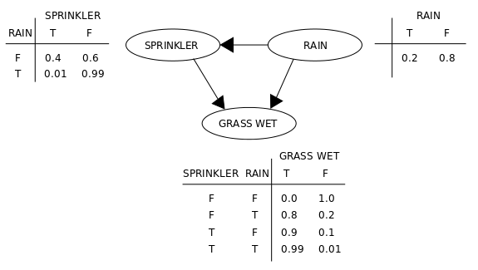
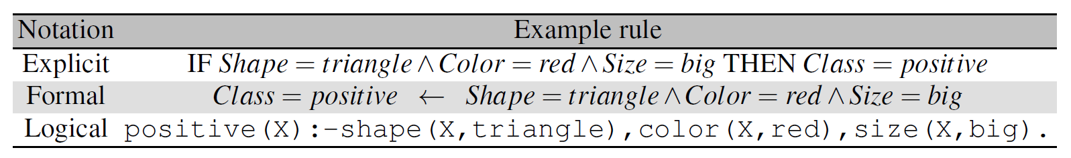
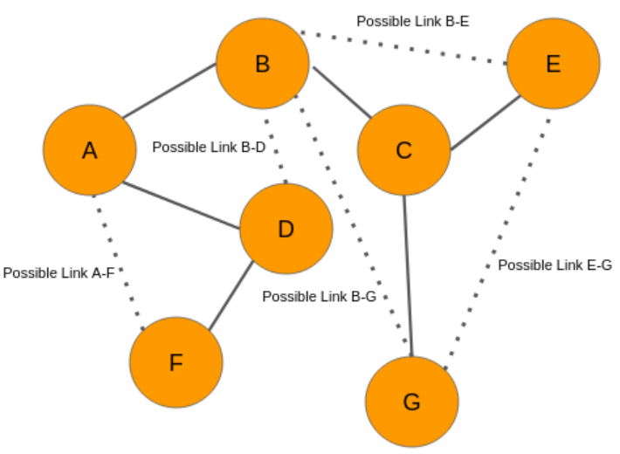
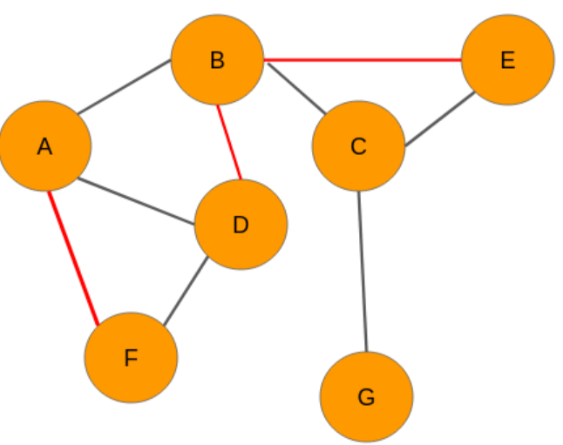
Relational learning
Several variants:
  Bayesian networks,
  inductive logic programming
  graph learning, e.g., link prediction

Slide 34
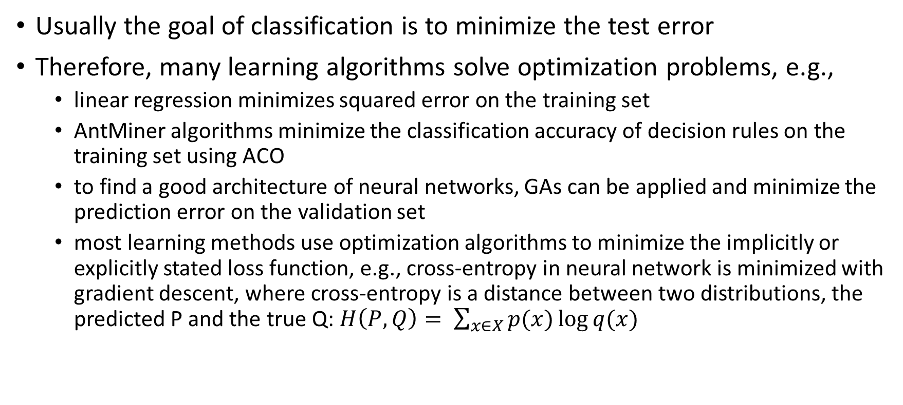
Learning as optimization
Usually the goal of classification is to minimize the test error
Therefore, many learning algorithms solve optimization problems, e.g.,
  linear regression minimizes squared error on the training set
  AntMiner algorithms minimize the classification accuracy of decision rules on the training set using ACO
  to find a good architecture of neural networks, GAs can be applied and minimize the prediction error on the validation set
  most learning methods use optimization algorithms to minimize the implicitly or explicitly stated loss function, e.g., cross-entropy in neural network is minimized with gradient descent, where cross-entropy is a distance between two distributions, the predicted P and the true Q: $H\left(P,Q\right)= \sum_{x∈X}{p(x)\log{q(x)}}$

Slide 35
Generalization as a search
So far, we presented the “learning as an optimization” ML view
Inductive learning: find a concept description that fits the data
Example: rule sets as description language
  Enormous but finite search space
Simple solution:
  enumerate the concept space
  eliminate descriptions that do not fit examples
  surviving descriptions contain target concept

Slide 36
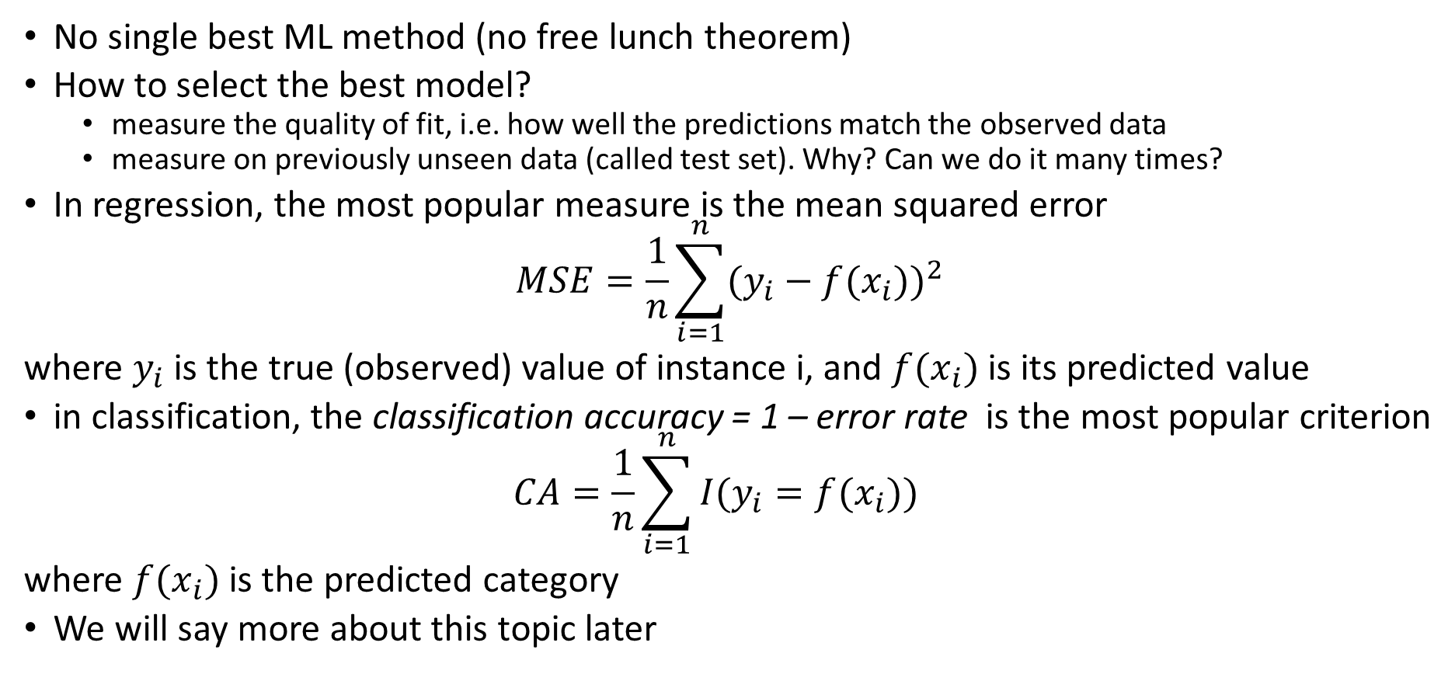
Criteria of success for ML
No single best ML method (no free lunch theorem)
How to select the best model?
  measure the quality of fit, i.e. how well the predictions match the observed data
  measure on previously unseen data (called test set). Why? Can we do it many times?
In regression, the most popular measure is the mean squared error
$$MSE=\frac{1}{n}\sum_{i=1}^{n}{{(y_{i}−f(x_{i}))}^{2}}$$
where $y_{i}$ is the true (observed) value of instance i, and $f(x_{i})$ is its predicted value
in classification, the classification accuracy = 1 – error rate is the most popular criterion
$$CA=\frac{1}{n}\sum_{i=1}^{n}{{I(y_{i}={f(x}_{i}))}^{}}$$
where $f(x_{i})$ is the predicted category
We will say more about this topic later

Slide 37

No-Free-Lunch theorem
In the "no free lunch" metaphor,
each "restaurant" (problem-solving procedure)
has a "menu" associating
each "lunch plate" (problem)
with a "price" (the performance of the procedure in solving the problem).
The menus of restaurants are identical except in one regard – the prices are shuffled from one restaurant to the next.
For an omnivore who is as likely to order each plate as any other, the average cost of lunch does not depend on the choice of restaurant.
But a vegan who goes to lunch regularly with a carnivore who seeks economy might pay a high average cost for lunch.
To methodically reduce the average cost, one must use advance knowledge of
  a) what one will order and
  b) what the order will cost at various restaurants.
That is, improvement of performance in problem-solving hinges on using prior information to match procedures to problems.

Slide 38
No-free-lunch theorem
For any two learning algorithms P₁(h|D) and P₂(h|D), the following are true, independent of the sampling distribution P(x) and the number n of training points:
Uniformly averaged over all target functions F,
ε₁(E|F,n) - ε₂(E|F,n) = 0.
For any fixed training set D, uniformly averaged over F,
ε₁(E|F,D) - ε₂(E|F,D) = 0
Uniformly averaged over all priors P(F),
ε₁(E|n) - ε₂(E|n) = 0
For any fixed training set D, uniformly averaged over P(F),
ε₁(E|D) - ε₂(E|D) = 0

Slide 39
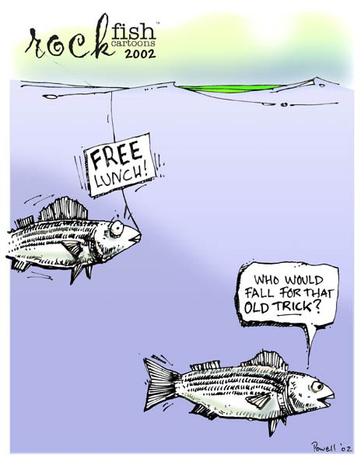
Consequences of the
NFL theorem
If no information about the target
function f(x) is provided:
  No classifier is better than some
  other in the general case.
  No classifier is better than random
  in the general case.
  ML practitioners possess implicit or explicit knowledge about the prices in different restaurants
  Meta-learning
  Automatic ML (AutoML)

